Slide 1
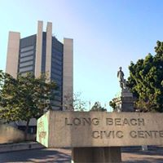
Belmont Shore Resident Association
May 2019
Councilwoman Price

Slide 2
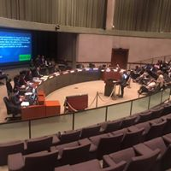
Agenda Items brought by my office
Bed Audit
CPTED Assessment of open spaces
Banning scooters on beach bike path
Beach enforcement plan
Beach signage
Comprehensive approach to homelessness
Bike registration program and funding for the program
Homeless day job program
Bike Chop Shop ordinance
Smoking Ban at restaurants
Banning RV parking

Slide 3
Public Safety Initiatives
More Quality of life officers
More heart teams
District 3 neighborhood impact prosecutor
Clinician in the jail
Property crimes are the biggest challenge
Increased patrols on the beach

Slide 4
Homelessness
24/7
Shelter
Service focus
Enforcement
Necessary for enforcement and a bridge for people who need it.
Faster encampment clean-up
More patrols
Interpretation of recent case law
Multi-Departmental Collaboration

Slide 5
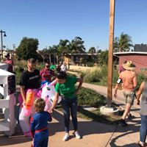
Parks & Facilities
Red Car Greenbelt – improved maintenance
Municipal band funded at current levels
Lighting through Marina Vista Park
Bayshore Lifeguard Station
Leeway Sailing Center Pier
Recreation in the Bay
Improvements to Bayshore Library are coming!
Improvements to medians
Working on new neighborhood park for UPENA

Slide 6
Colorado Lagoon
Long Term sustainable Asset
Open Channel between Marine Stadium and Colorado Lagoon
First Coastal Mitigation Bank in CA

Slide 7
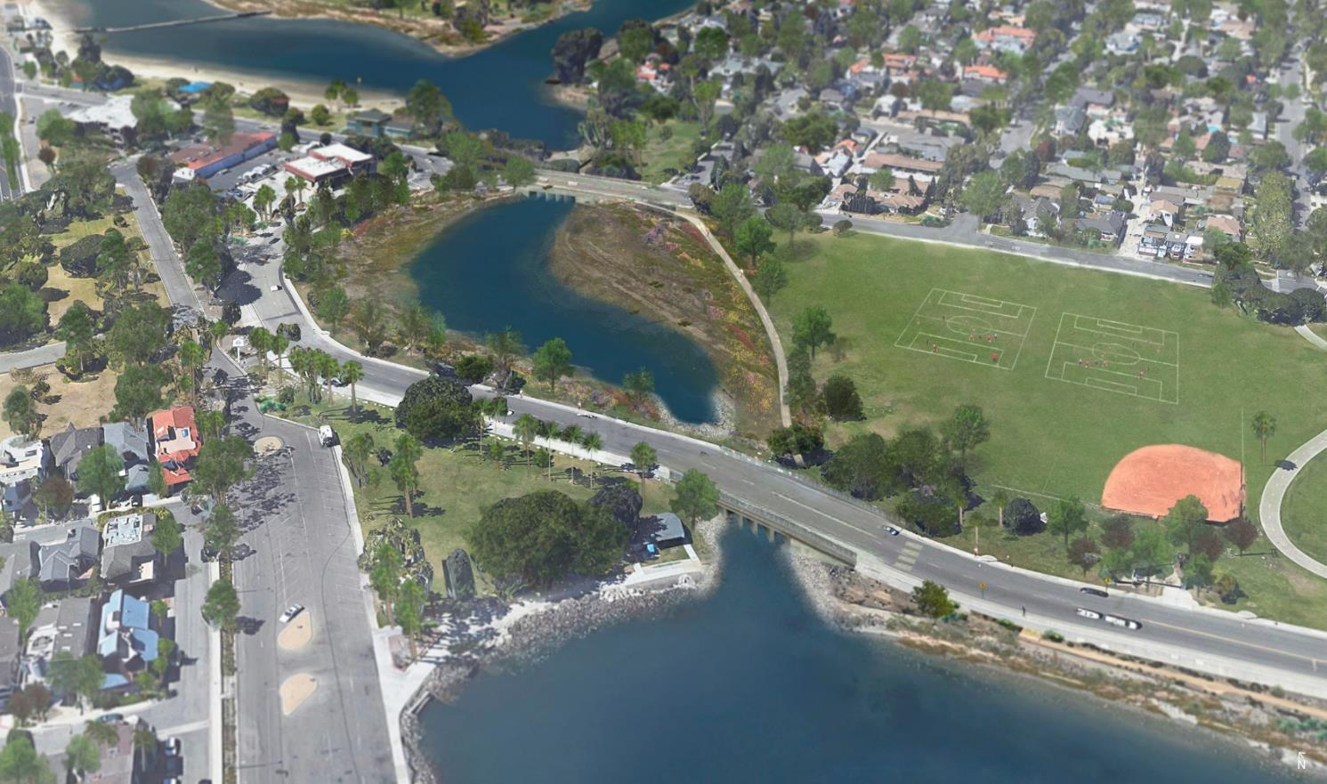
Proposed Open Channel
Notes:
Earthen waterway
Restores full tidal regime to Colorado Lagoon
Provides habitat connectivity from Alamitos Bay to Colorado Lagoon
Serves as a model for creative partnerships to fund high-value restoration projects

Slide 8
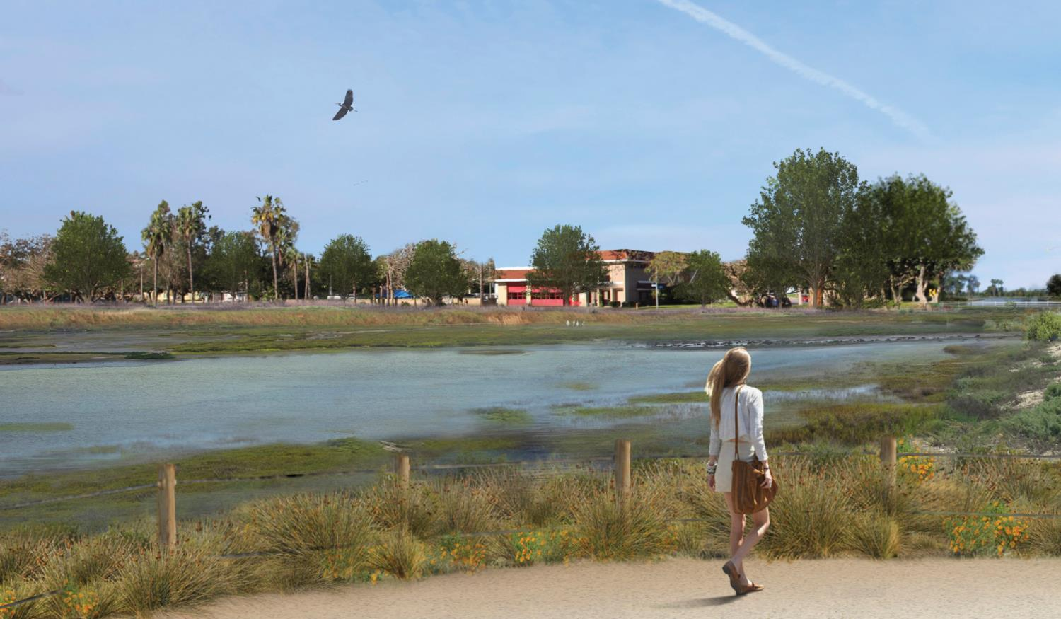
Natural open channel with mix of tidal habitats
Notes:
Creates valuable subtidal, mudflat and marsh habitats

Slide 9
CAAP- Climate Action Adaptation Plan
We need to plan ahead and communicate
This is real as we see extreme heat waves, rising sea-levels, and storm events that are stronger and more frequent.
This is a major issue for the 3rd district
Our plans can’t be just about reducing emissions, planting more trees or increasing solar panels. We can’t mitigate what has already happened.
Engineering solutions already being implemented but more are to come.

Slide 10
Belmont Shore Businesses
Standing no trespass order program is being used
New businesses coming
Louie’s on 2nd to replace Acapulco Inn
Pressed Juicery to replace Jamba Juice
El Pollo Loco to replace Jack in the Box
Mac’s on 2nd was Belmont Shore Liquor
Natural Bowls
House of Intuition replaced Rubber Tree
Shara replaced Laurenly
Proper replaced Romance Etc.
Philz, Lash Lounge and Earl of Sandwich replaced Children’s Place
@Sushi replaced Theory Café
LB Tap House will replace Tavern on 2
O Gourmet will replace Babette’s Feast
Possible consideration to changes in parking meter maximum times and use of parking application

Slide 11
Short Term Rentals
Was able to convince my colleagues to go with the option that gives neighborhoods the option to petition against them, but the “neighborhood” selection has not be defined.
Most of council was very much in support of allowing them in the City.
Many local property owners are also home sharing hosts. That seemed to be less of an issue for most of the people in our community.

Slide 12
2nd and PCH development and surrounding
Development is underway.
Marina Drive will have a “complete streets” restriping.
San Pedro Fish Market is coming. Lots of visitors expected.
Parking has been reconfigured to add more spaces.
Signal synchronization will happen.
Super blocks will be broken up.

Slide 13
Tenant Relocation Policy
Voted against policy that would take away property owner discretion.
Support helping people move to a new location if there was no problem with them as tenants and reason being asked to leave is that the building is being converted or torn down, or if the rent increases so much at once that they cannot afford it and need to move.
But setting very limited circumstances in which a property owner can ask someone to leave without essentially paying a $4,000 fine isn’t good for our apartment communities, or property owners.
Issues like this do not solve homelessness, and anyone who tells you otherwise is probably trying to get you ready to swallow a tax or a bond to build low income housing.

Slide 14
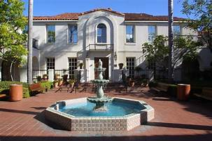
Community hospital
We have reached an agreement on Community Hospital;
City will commit to $25 million for seismic retrofit over 25 years;
Hope to reopen acute care services by the end of 2019

Slide 15
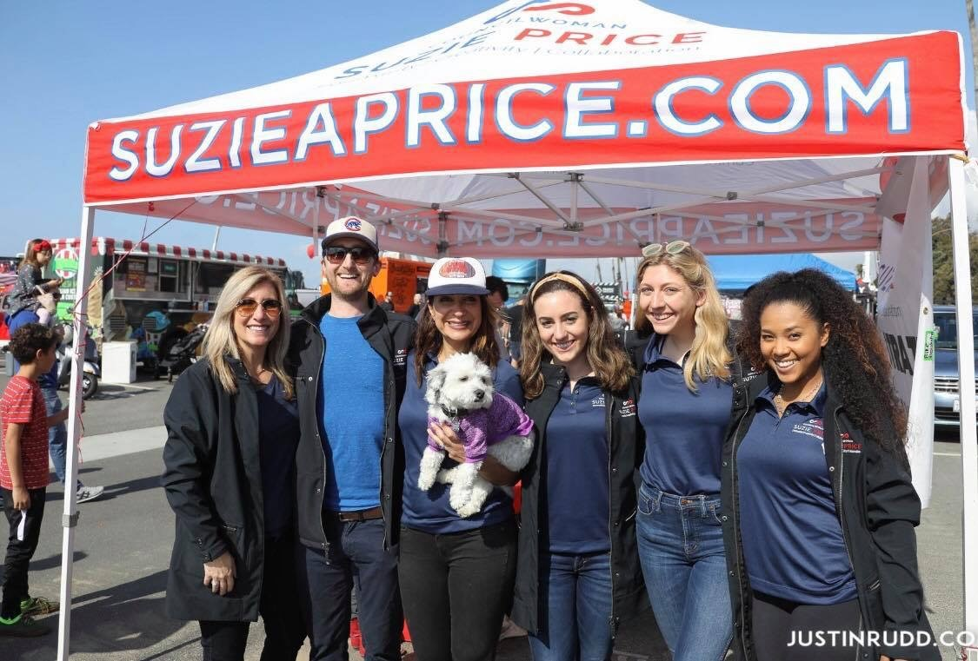
Thank You district3@longbeach.gov

